Slide 1
Lab5 FlashAttention
Nov, 2024 Parallel Programming

Slide 2
Overview
Platform Guide (NCHC CT)
Attention
FlashAttention
Lab5 Assignment

Slide 3
Platform Guide (NCHC CT)

Slide 4
NCHC Container
Webpage: https://portal.apps.edu-cloud.nchc.org.tw
Register your account first
GPU: RTX 3070
Available time: Tuesday, Wednesday and Sunday 00:00-23:59
Total available GPUs: 46
Please stop your container if you aren’t using it

Slide 5
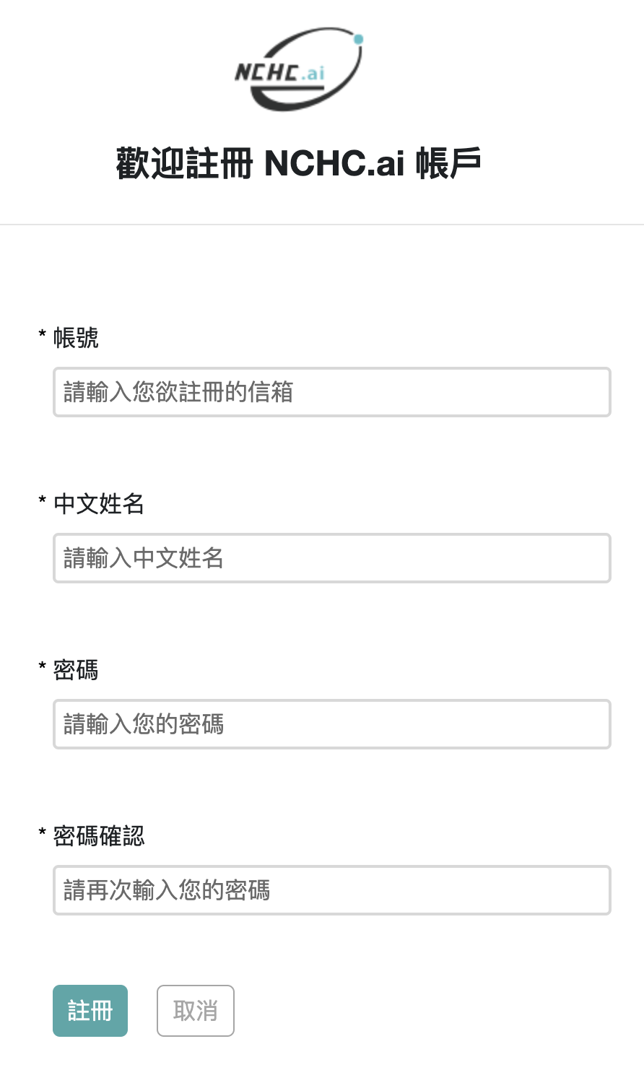

Register
1
Your gmail account
Enter whatever you want
2

Slide 6
Login

Slide 7
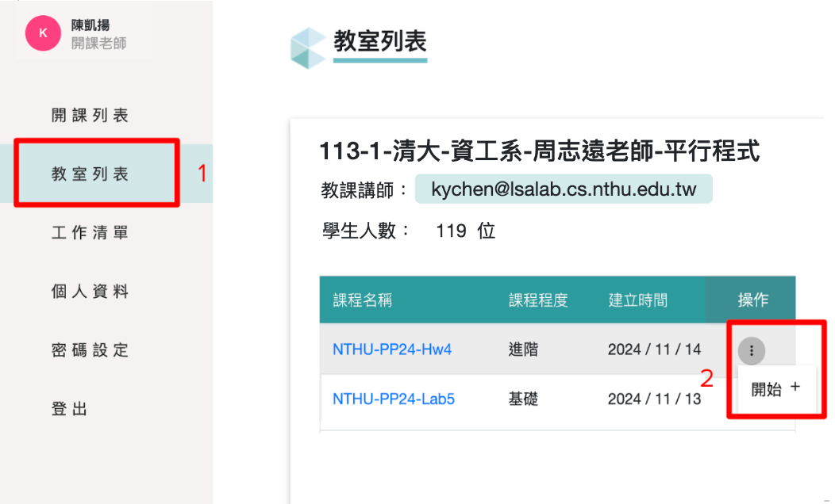
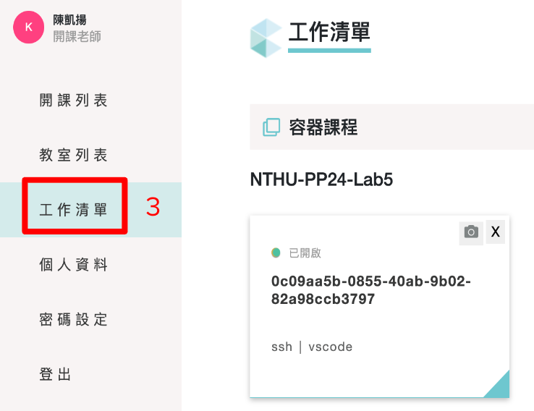

Start Container
3

Slide 8
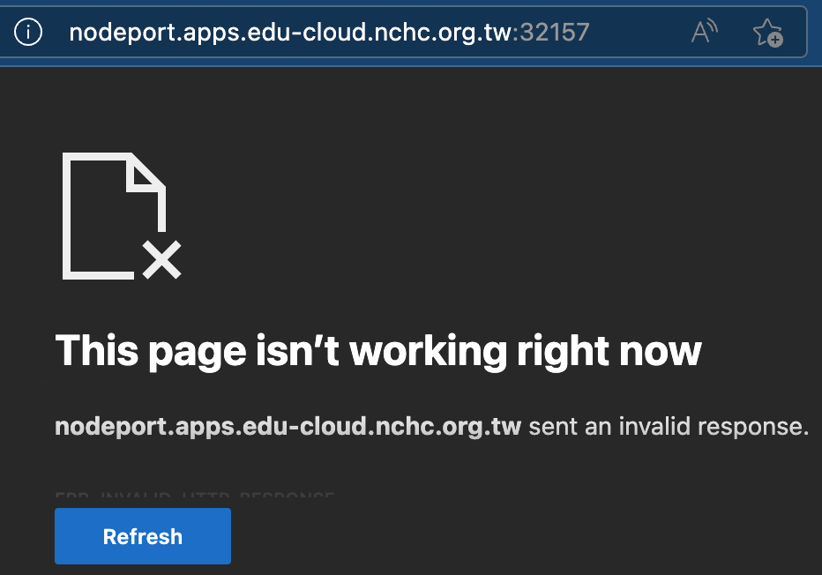
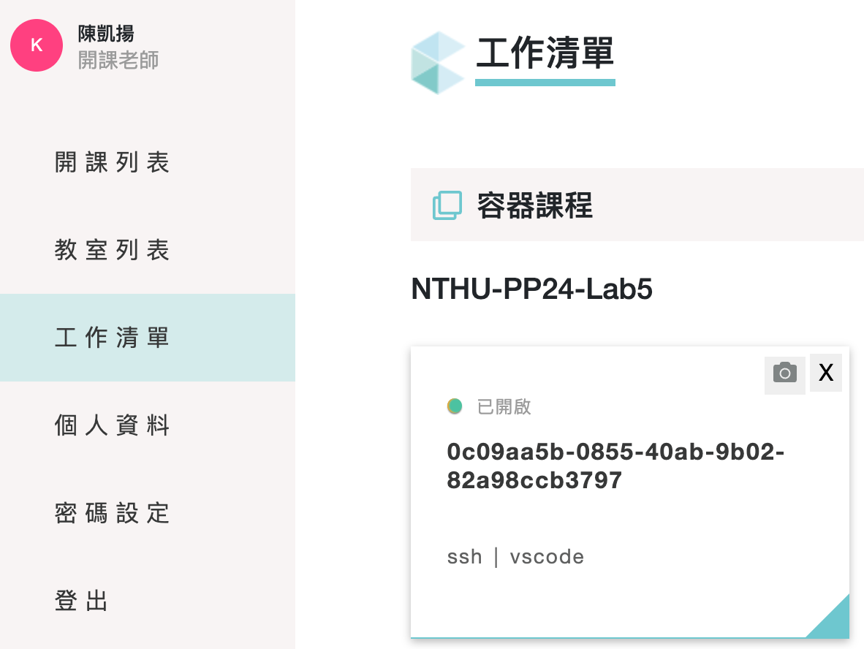
Access the Container
SSH
The port number will be different
Codeserver (the web version of vscode)
Click the “vscode” button
MobaXterm or Terminal:
ssh root@nodeport.apps.edu-cloud.nchc.org.tw -p 32157

Slide 9
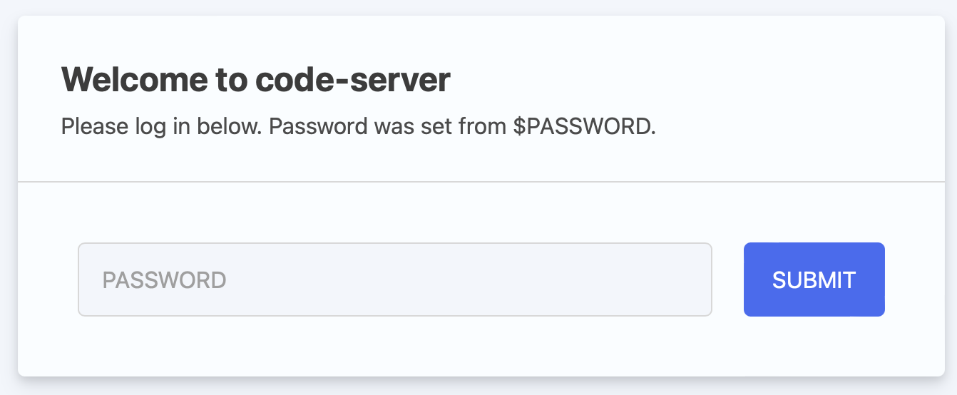
User & Password
User: root
Password: student
The password of ssh and code-server is the same

Slide 10
First-time Setup Script
Open terminal in the container:
bash <(curl -s https://apollo.cs.nthu.edu.tw/pp24/share/script/setup-remote.sh)
The script will execute the following commands:
Set proper bash config for homework judger (e.g., hw4-remote-judge)
Generate ssh key and install it on Apollo (you will be prompted to enter your Apollo account name and password)
Run this script only once, even you relaunched your container (since your personal data will be kept).

Slide 11
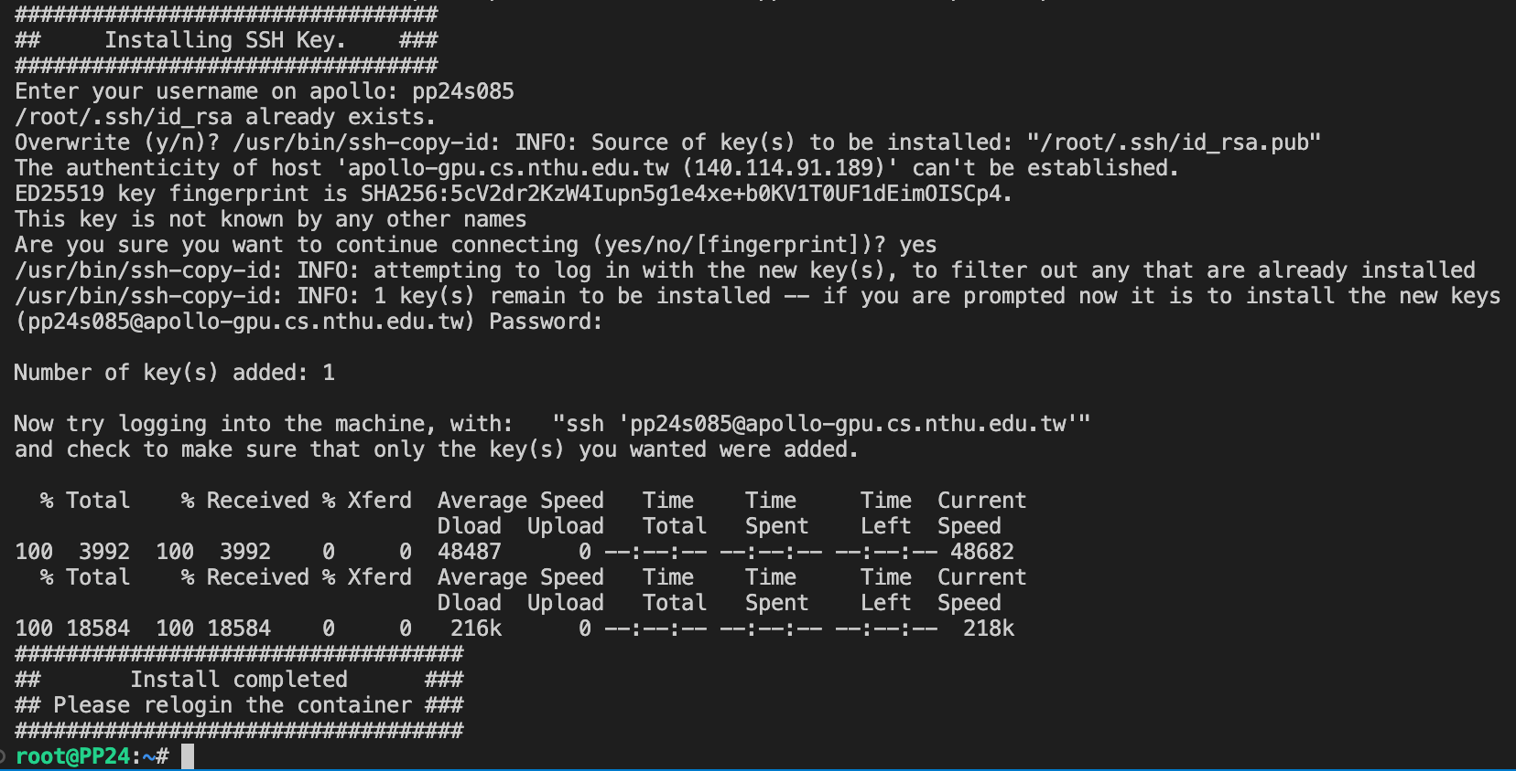

Slide 12
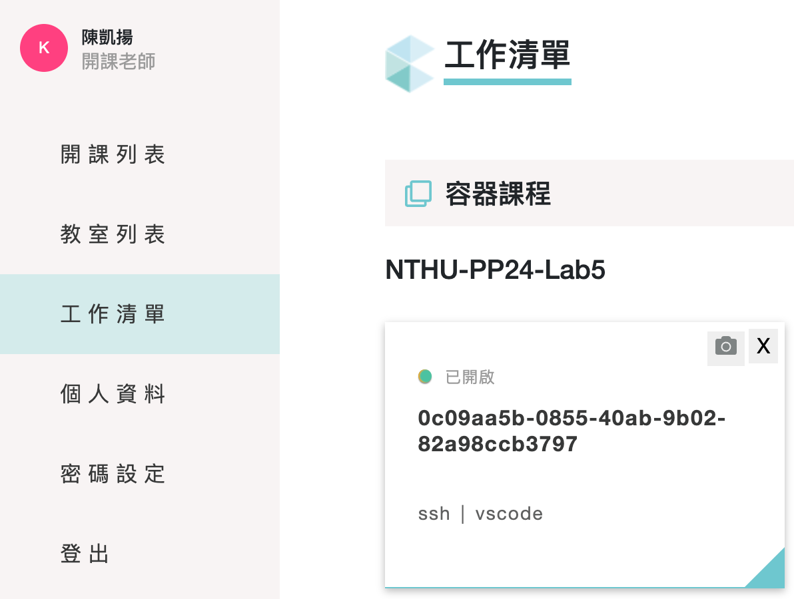
Stop your container
Please stop your container if you aren’t using it; otherwise, other students may not have enough GPU resources
Your files located under $HOME (/root/) will be preserved

Slide 13
NO MINING
Educational use only
Please cherish the computing resources we provided

Slide 14
Attention

Slide 15
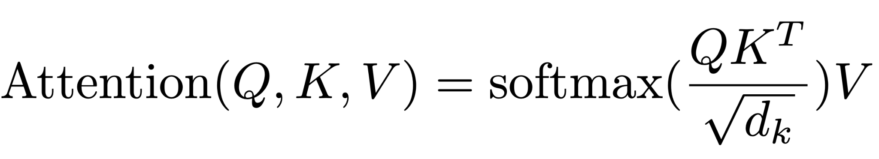

Attention
Q: What we're focusing on.
K: What features are available.
V: What content is retrieved based on focus.

Slide 16
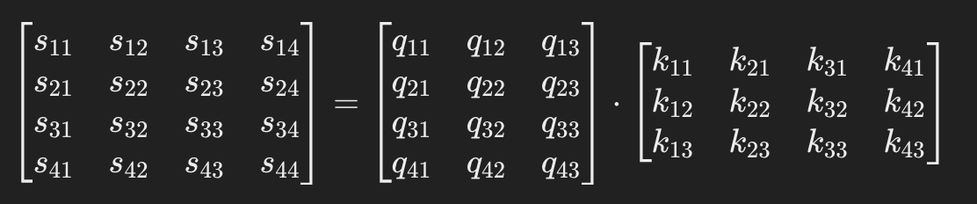
Attention

Slide 17
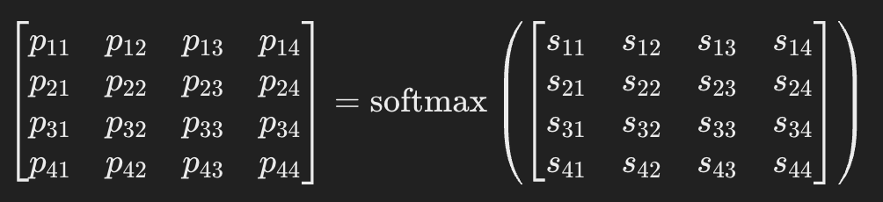
Attention

Slide 18
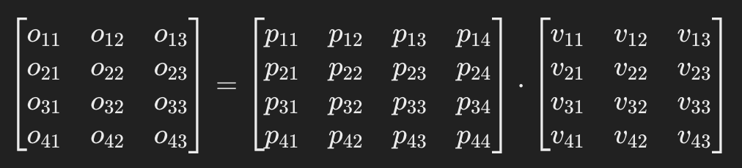
Attention

Slide 19
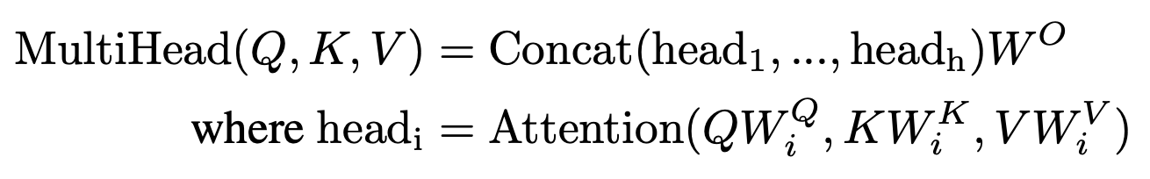
Multi-Head Attention
Rich Representations
Efficient Parallelization
E.g. emb_dim = 4096 -> num_heads = 32, head_size = 128

Slide 20
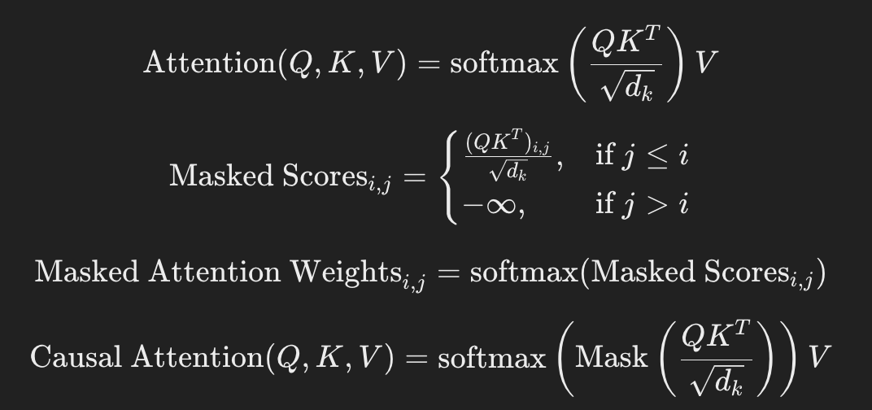
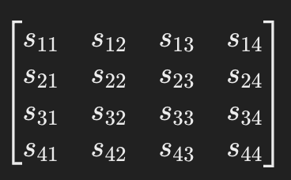
Causal Attention
If you’re predicting the next word in a sentence, the model shouldn’t have access to future words beyond the current position.

Slide 21
FlashAttention

Slide 22
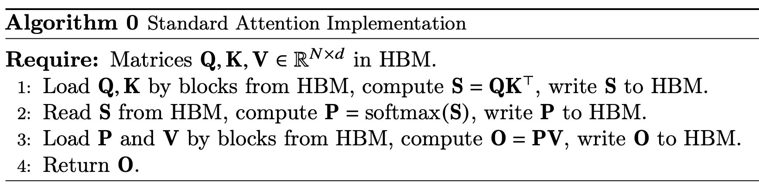
FlashAttention - Overview
Goal: avoid reading and writing the attention matrix to and from HBM.
Computing the softmax without access to the whole input.
Not storing the large intermediate attention matrix for the backward pass.

Slide 23
FlashAttention - Method
Tiling: split the input into blocks and make several passes over input blocks.
Matrix multiplication and pointwise operations are easy to handle.
SoftMax: need to maintain m(x), l(x).
Recompute: store the softmax normalization factor in order to quickly recompute in the backward pass.

Slide 24
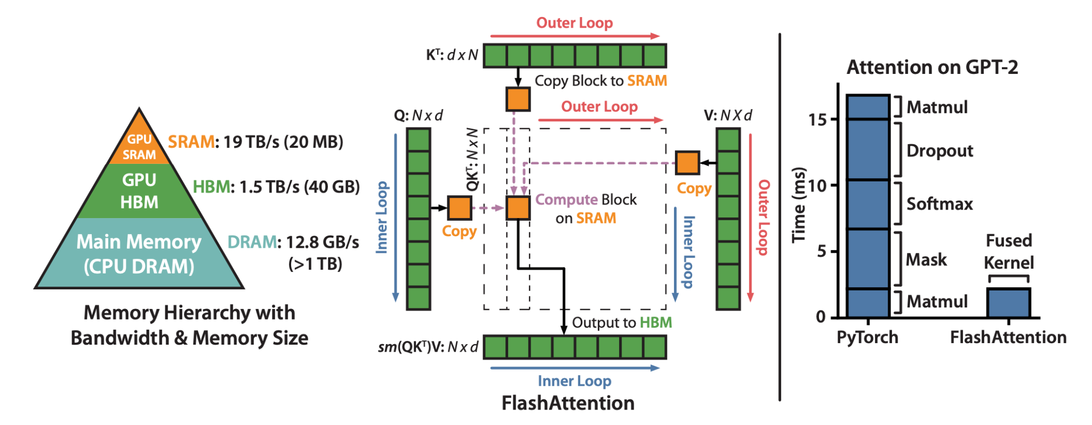
FlashAttention

Slide 25
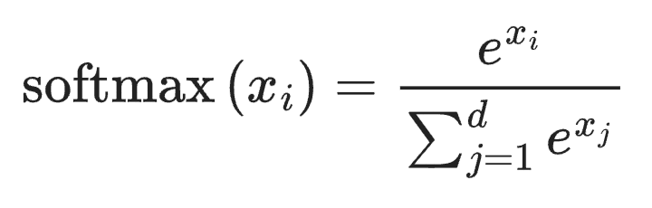
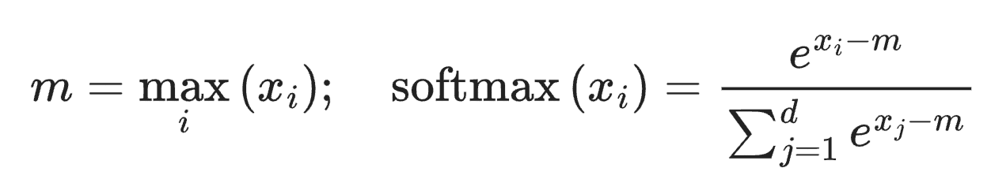
FlashAttention - SoftMax

Slide 26
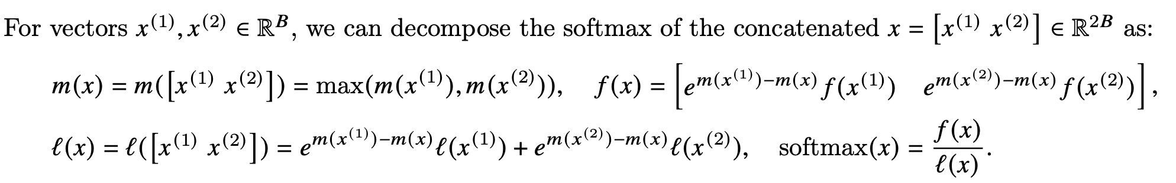
FlashAttention - SoftMax

Slide 27
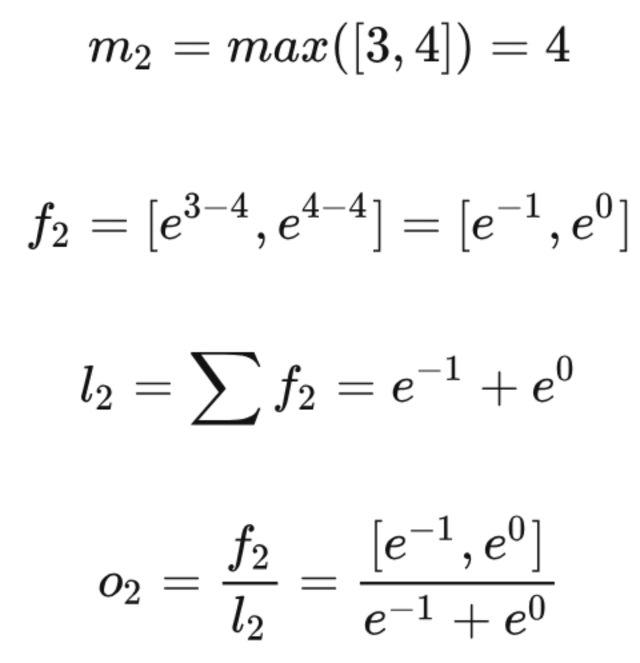
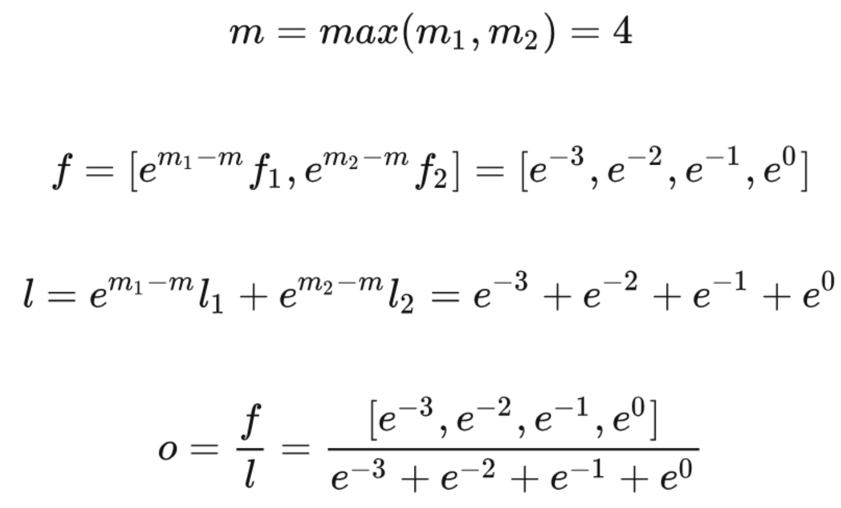
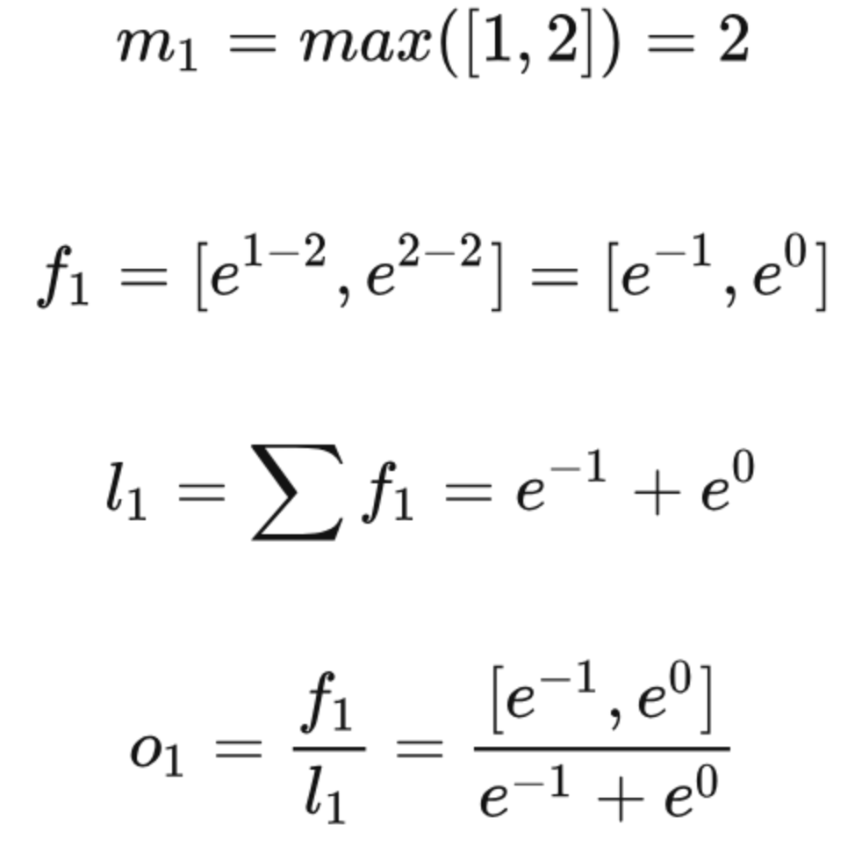
FlashAttention - SoftMax

Slide 28
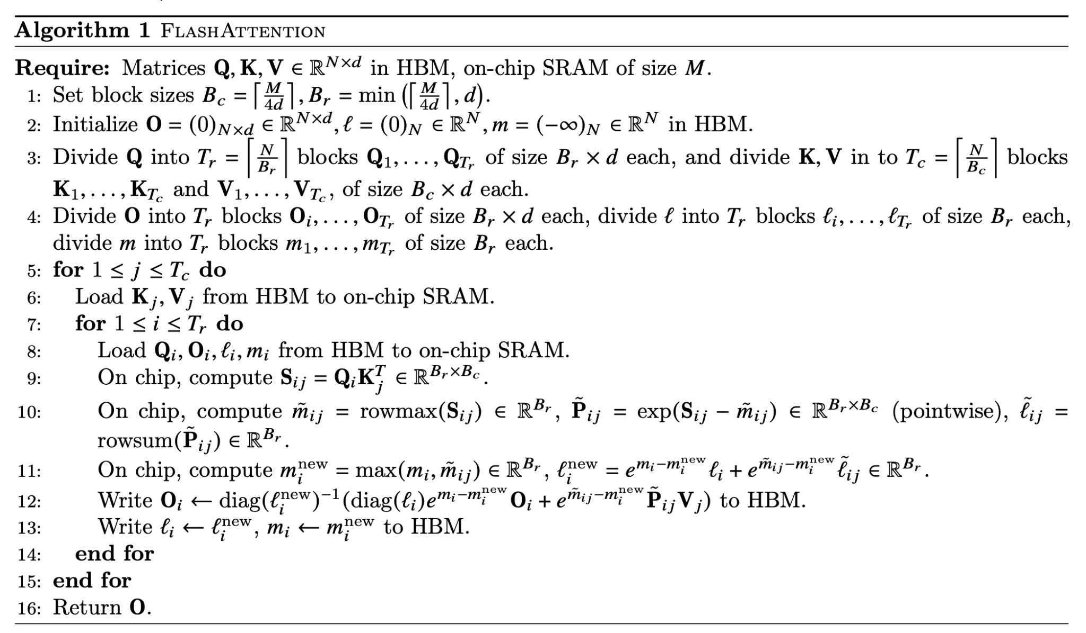
FlashAttention - Algorithm

Slide 29
Reference
https://arxiv.org/pdf/2205.14135
https://www.cvmart.net/community/detail/7943
https://www.youtube.com/watch?v=eMlx5fFNoYc

Slide 30
Lab5 Assignment

Slide 31
Objective
Evaluate the performance of attention mechanisms by comparing:
The original PyTorch implementation
The FlashAttention v2 implementation
Analyze the benefits of FlashAttention and explore its advantages over the standard approach.
Conduct benchmarking with varying parameters and compare the results to gain deeper insights.

Slide 32
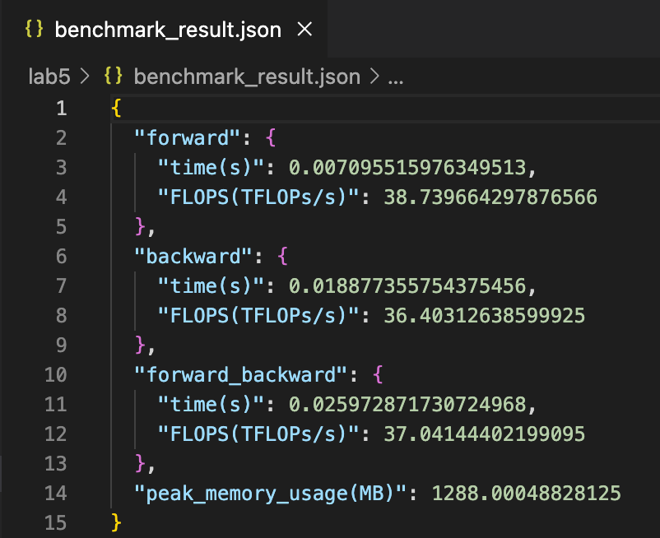
Benchmark Script
TA provide the Python benchmark script that does not require any modifications.
Your task is to adjust only the parameters within the benchmark.
The result will be outputted to a JSON file.
Execution time
FLOPs
Peak memory usage

Slide 33
Benchmark Script
Test following parameters and compare the results.
batch_size: int
seq_len: int
num_heads: int, (must be divisible by emb_dim)
emb_dim: int
impl: str, (choose between Pytorch and Flash2)
causal: bool

Slide 34
Preparation
File are Located at /tmp/lab5 on NCHC.
The benchmark script is named lab5.py.
Use python lab5.py --help to view detailed parameter descriptions.
Important Notes:
Do not modify the source code.
Do not merge multiple tests into a single run, as this may result in incorrect output values.
To run multiple tests, you can use a bash script for automation.

Slide 35
Workflow
cp -r /tmp/lab5 ~/lab5 && cd ~/lab5
python lab5.py \ --batch_size 32 \ --seq_len 1024 \ --num_heads 32 \ --emb_dim 2048 \ --impl Flash2 \ --causal \ --repeats 30 \ --output benchmark_result.json

Slide 36
Submission
Plot the experimental data in a chart for better visualization.
Analyze and explain your observations based on the collected data.
Submit your report as a lab5.pdf file to eeclass before 11/28 23:59.
Important Notes:
Get started as soon as possible since the NCHC platform is only accessible on Tuesday, Wednesday and Sunday.
Remember to stop your container when not in use.

